Slide 1
IMT 577
Stores 10 & 21
Team 5
Aayushi Gandhi
Harshi Thaker
Brinda Sarkar

Slide 2
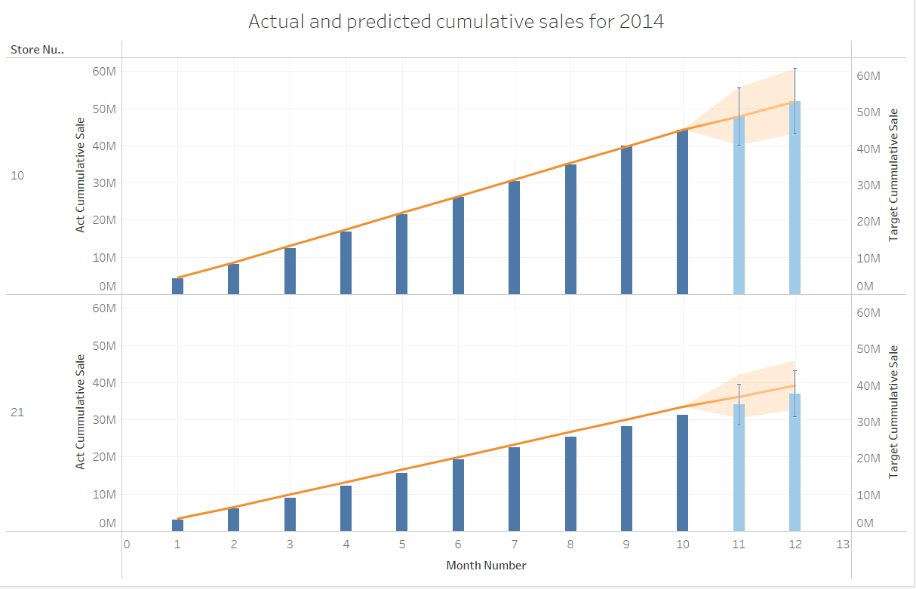
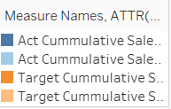
Q1.a. How are both stores performing according to target?
Details :
The plot displays actual and targeted sales for 2014 for both stores 10 and 21 for the months of January to October. Based on their performance during this period, we build predictions for the sales during the months of November and December.

Slide 3
Q1.a. How are both stores performing according to target?
Analysis :
From the graph, we can say that store 10 performs better than store 21 in terms of achieving their targeted sales amount.
Notes:
We can say that store 10 is very likely that it will meet its 2014 target by the end of the year. However, as for store 21, it has a very close margin and hence it is difficult to predict whether or not it will be able to meet its 2014 target.

Slide 4
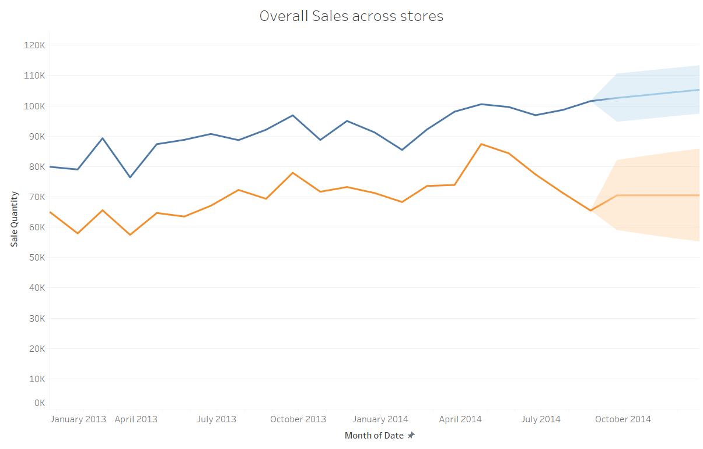
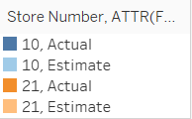
Q1.b. Should either store be closed?
Details:
The graph represents overall trend in sales for 2013 and 2014 for both the stores.

Slide 5
Q1.b. Should either store be closed?
Analysis :
Both the trend lines are indicative that each store did face some profit and loss periods, especially in 2013. As for 2014, we can see better, stable patterns in sales trends.

Slide 6
Q1.b. Should either store be closed?
Analysis :
For store 10, we can say that the store has performed well and is predicted to perform even better in the last quarter of 2014.
For store 21, there is not much improvement in performance that is expected, however, it seems to perform satisfactorily.
Notes:
As for whether or not any of the stores need to be closed, we can say with surety that store should not be closed as it is likely to become more profitable in the near future. As for store , we can say that we do not have sufficient information from the data that we have in order to make a call regarding whether or not the store needs to be closed. However, atleast according to sales, we can say that it will have average performance, and since it is not expected to be loss-making, we can suggest to wait till the end of the year and analyse the sales trends, predicted vs actual, and then during or after the first quarter of, decide if the store needs to be closed.

Slide 7
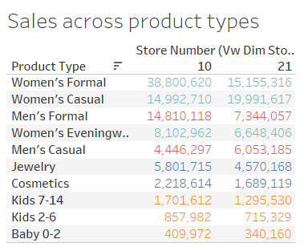
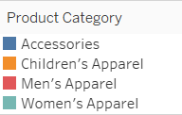
Q1.c. What should be done in the next year to maximize profits?
Details :
The graph shows the most selling products across different product types and grouping them into product categories, in a decreasing order.

Slide 8
Q1.c. What should be done in the next year to maximize profits?
Analysis :
We can see from the graph that women’s apparel is the product category generating the most revenue at both stores 10 and 21.
Recommendation :
We recommend that both the stores increase product sales in the women’s apparel category.i.e. Women’s formal and women’s casual.

Slide 9
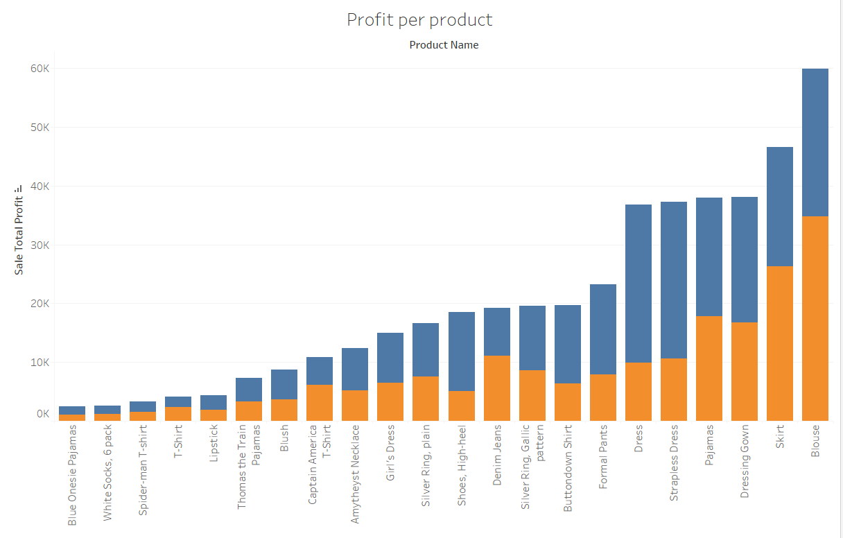

Q1.c. What should be done in the next year to maximize profits?
Details :
The graph displays the most profitable products in increasing order, across the two stores.
Notes:
In order to maximize profits, we identified the best-selling products at each store.

Slide 10
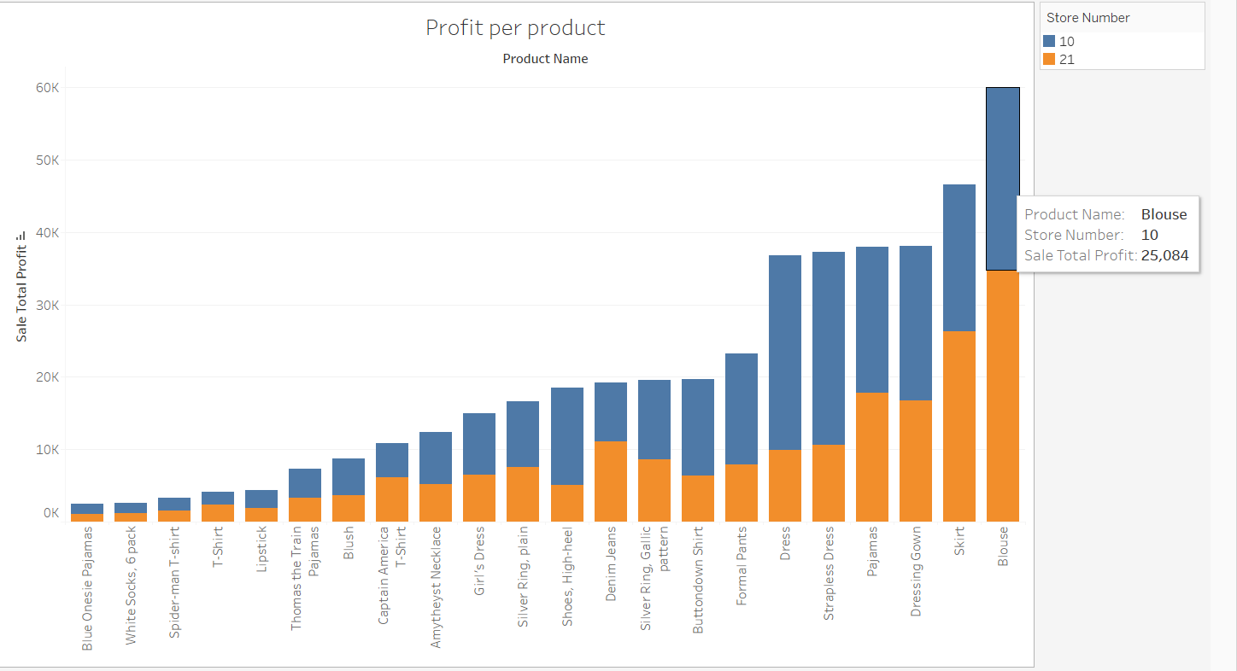
Q1.c. What should be done in the next year to maximize profits?
Analysis :
We identify which products are the most profitable in each store. For example, for store 10, blouses have the highest profit in comparison to all other products in the same store.
Recommendation :
Increases the sales of the top 5 most profitable products.

